Slide 1
Workflow Recovery System
Eastern Eagles Team:
Mateusz Gołąb
Csaba Kerti
Jakub Kiełbasa
Zsolt Kollarits

Slide 2
Presentation Plan
Team Management [short Kuba]
Goals and Objectives [short Kuba]
Design Applied [Mat]
Testing Strategy [Csaba]
Prototype Demonstration [Zsolt]
Costs Identification [short Zsolt]
Summary and Discussion [all]
Notes:
Sept 2010

Slide 3
Team Management

Slide 4
Team Management

Slide 5
Team Management

Slide 6
Team Management

Slide 7
Goals of the Project

Slide 8
Goals of the Project

Slide 9
Goals of the Project

Slide 10
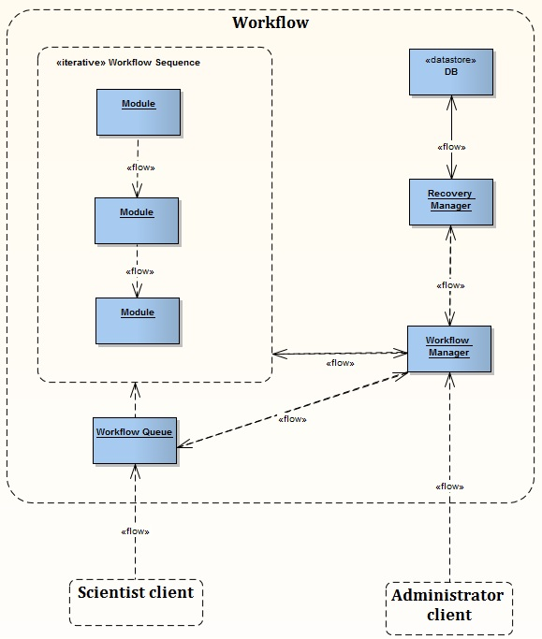
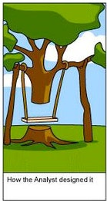
Design of the Project
System Architecture
Client – Server
Workflow
Scientist client
Administrator client

Slide 11
Design of the Project
Workflow Patterns perspectives
Sequential Workflow
Task Data
Automatic execution
Recovery action
Control Flow Pattern
Data Pattern
Resource Pattern
Exception handling
pattern

Slide 12
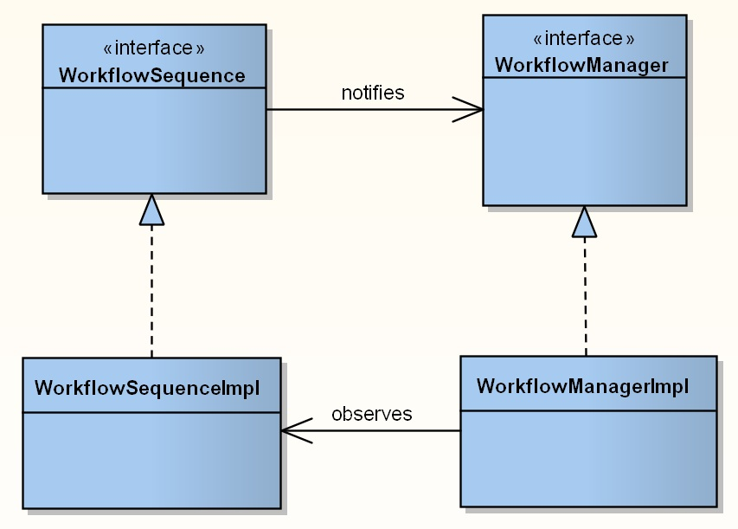
Design of the Project
Behavioural pattern
Observer

Slide 13

Design of the Project
Backup policy
Stable points based
Module dependent
Dynamic
Configurable

Slide 14

Design of the Project
Recovery mechanism
Stable points driven
Configurable
Strategy
last stable point
previous stable points
failure actions

Slide 15
Testing Strategy

Slide 16
Testing Strategy

Slide 17
Testing Strategy

Slide 18
Testing Strategy

Slide 19
Testing Strategy

Slide 20
Implementation

Slide 21
Implementation

Slide 22
Implementation

Slide 23
Demonstration

Slide 24
Costs

Slide 25
Costs

Slide 26
Costs

Slide 27
Summary

Slide 28
Question?

